Slide 1
Data Examination
David Mukajanga

Slide 2
What is Data Examination
It is the process of making sure the data at hand is appropriate for the intended form of statistical analysis.
It is an important step since it makes sure that the analyses that will be conducted from-there-on will not give misleading results.
It involves:
Checking if the Data Complies With The Statistical Assumptions
Identifying Outliers
Identifying Missing Values
Developing a Preliminary Understanding of the Data.
Graphical methods of data examinations are among the easiest and straightforward methods that enables researchers to achieve the aforementioned objective with a minimum of strenght.

Slide 3
Prerequisites to Data Examination
The researcher should have the conceptual understanding of the study being done.
This will help them know what to look forward to and what to not look forward to concerning the nature of data.
Basic descriptive statistics including mean, mode and correlation coeffiencients are always the first step because they set the stage for graphical and empirical methods of data examination being possible.
Depending on the nature of the research study in question, the researcher might be tasked with the process of making sure that the sources of data and the data collection process were of good quality and dependable.

Slide 4
1. Graphical Data Examination
The researcher can do the graphical examination of data on three levels
The Univariate Level
He/she will be looking at the characteristics of a single variable at a time
Very useful in evaluating the shape of the statistical distribution whether normal or not
Uses Histograms,
The Bivariate Level
Where he/she will be examining the nature of relationship between one variable and another or one group of respondents and another one in the data.
Scatter plots are commonly used to check the nature of relationship between variables while Box and Whiskier charts to comparing groups between respondents.
One can check if the assumption of linearity is met by using the scatter plot
Box and Whiskier graphs can be used reliably to detect outliers.

Slide 5
Graphical Data Examination Continued...
The Multivariate Level
He/she is evaluating the relationships existing between one metric variable in relation to other multiple metric variables.
Chernoff-Faces are pretty useful for this purpose.
Others methods include glyphs, metroglyphs and Andrew’s Fourier’s Transformation.

Slide 6
2. Verifying That Assumptions are Met
The main four statistical assumptions to look for closely are:
Linearity
Because all multivariate techniques uses correlational measures of assosiciation which only measures linear correlation between variables of interest.
Scatterplots and Scatterplot Matrices does a good job in showing whether linearity exists between variables of interest or not.
Data transformation in one or both variables is a remedy if there isn’t linearity.
Normality
That all the variables of interests follow a normal distribution
Can be assessed by using a combination of a Histogram and a Normality Curve
Normality at the univariate level often leads to normality at the multivariate level although there is no guarantee.
Increasing the sample size helps reducting the impacts of departures from normality
Notes:
Normality is checked by looking at the kurtosis values (Peakedness) and skewedness values. Departures of these values from zero shows that the distribution is departing from normality.

Slide 7
Verifying Assumptions..
Homoscedacity
That all dependent variables have almost an equal level of dependence to the independent variables.
Heteroscedacity can result as a result of non-normality and most of the times, the data transformations used to treat non-normality also cures heteroscedasticity.
Multiple regression is used to test Homoscedasticity if the independent variable is metric and ANOVA and MANOVA if the independent variable is non-metric.
Non-Correlated Errors
That errors in prediction should not be correlated with each other.
If they do, the researcher should look around to identify which factor outside the scope of the study is influencing the dependent variable and include it in the analysis.
Analyzing groups differently also helps reducing the correlated errors arising from using the same parameter on different groups.
Notes:
One parameter can have a strong influence in one group but none on the other or influence it in un-foreseen ways.

Slide 8
3. Identifying and Dealing With Missing Values
This is the critical data that was asked by the researcher during data collection but was not provided by respondents.
Missing data can be Missing Completely at Random (MCAR), Missing At Random (MAR) or Missing Not At Random (MNAR).
Data is Missing Completely At Random (MCAR) when the missing data does not have any correlation with any variable of interest.
Data is Missing At Random (MAR) when the missing data correlates with one or more variable. Eg, Missing data is only found on variable income, meaning people were purposevely not answering questions related to income.

Slide 9
Missing Data..
Data is Missing Not At Random (MNAR) when the missing data is due to an event that was known to the researcher, eg. Missing data on meat consumption in vegeterian cultures like India etc.
Handling missing data depends on the randomness and extent of the missing data.
One can choose to only use observations with complete data.
One can delete variables (If he/she can afford to)
One can estimate the values of the missing values
The extent of 10% with minimum randomness can be ignored, but the complete cases should be adequate for the study. Any imputation method can be used in this extent.
Hot deck regressions are used for any extent between 10, 20% and above for MCAR and Model-Based methods for MAR.

Slide 10
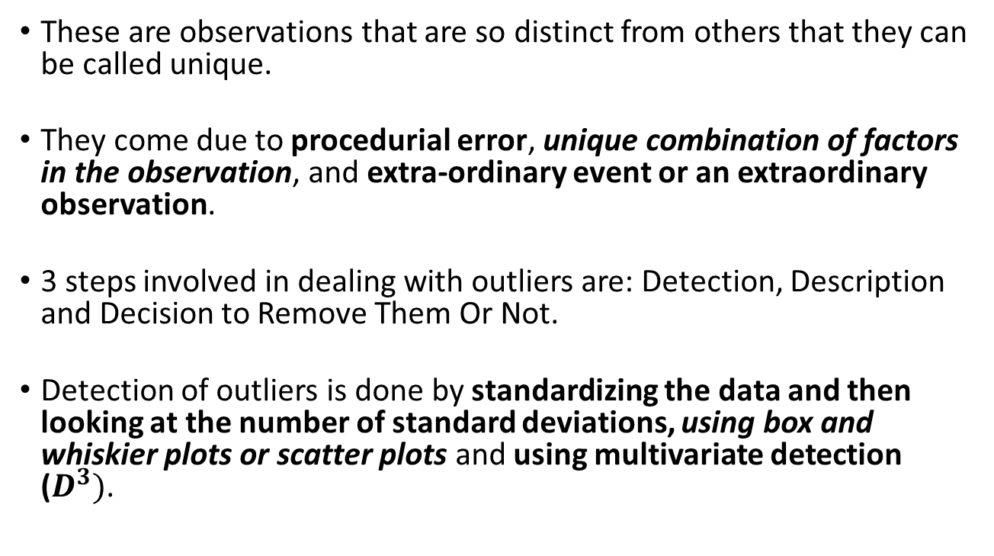
4. Detecting Outlires
These are observations that are so distinct from others that they can be called unique.
They come due to procedurial error, unique combination of factors in the observation, and extra-ordinary event or an extraordinary observation.
3 steps involved in dealing with outliers are: Detection, Description and Decision to Remove Them Or Not.
Detection of outliers is done by standardizing the data and then looking at the number of standard deviations, using box and whiskier plots or scatter plots and using multivariate detection ($D^{3})$.

Slide 11
Data Transformations
A procedure done to a certain variable, making it show the underlying meaning of its values in a different way so that the variable complies with the statistical assumptions or becomes easier to interpret.
For making a variable comply with statistical assumptions, data transformation can be done in curing non-normality / heteroscedacity or linearity.
For non-normality/Heteroscedasticity...

